Slide 1
Entity Relationship Modeling
Module 8
Prepared by: Engr. Ryan D. Francisco

Slide 2
4.1 The Entity Relationship Model (ERM)
ER model forms the basis of an ER diagram
ERD represents conceptual database as viewed by end user
ERDs depict database’s main components:
Entities
Attributes
Relationships

Slide 3
Entities
Refers to entity set and not to single entity occurrence
Corresponds to table and not to row in relational environment
In Chen and Crow’s Foot models, entity is represented by rectangle with entity’s name
The entity name, a noun, is written in capital letters

Slide 4
Attributes
Characteristics of entities
Chen notation: attributes represented by ovals connected to entity rectangle with a line
Each oval contains the name of attribute it represents
Crow’s Foot notation: attributes written in attribute box below entity rectangle

Slide 5
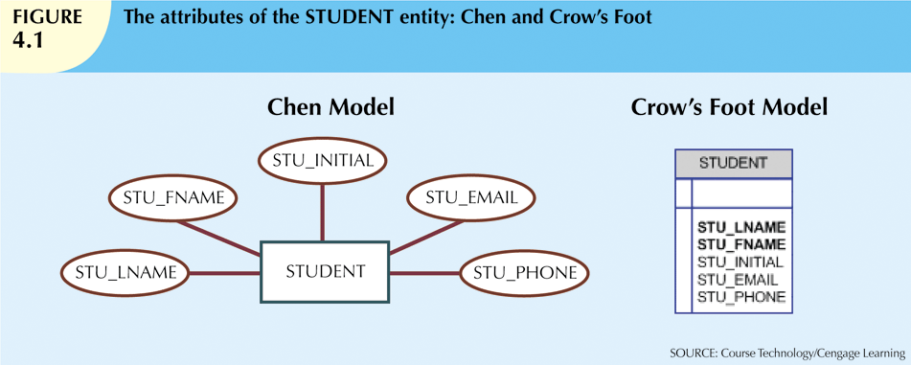
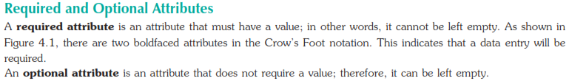

Slide 6
Attributes (cont’d.)
Required attribute: must have a value
Optional attribute: may be left empty
Domain: set of possible values for an attribute
For example, the domain for the grade point average (GPA) attribute is written (0,4) because the lowest possible GPA value is 0 and the highest possible value is 4.
Identifiers: one or more attributes that uniquely identify each entity instance
Composite identifier: primary key composed of more than one attribute

Slide 7


Identifiers (primary keys)
Identifiers: one or more attributes that uniquely identify each entity instance
Composite identifier: primary key composed of more than one attribute

Slide 8
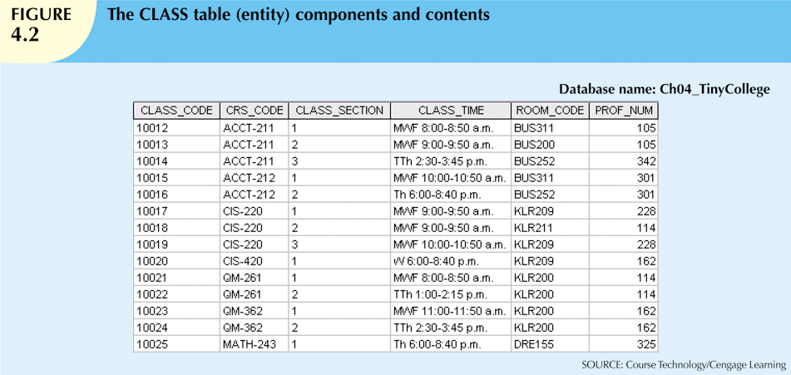

Slide 10
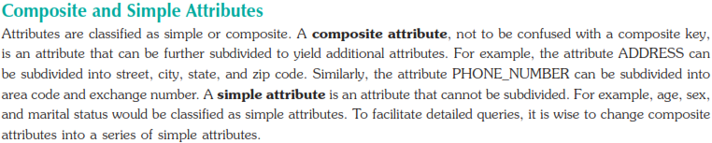
Attributes (cont’d.)
Composite attribute can be subdivided
Simple attribute cannot be subdivided

Slide 11
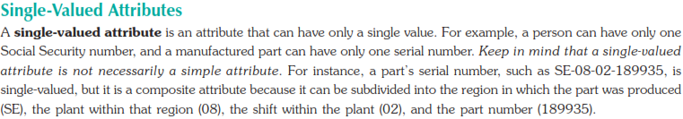
Attributes (cont’d.)
Single-value attribute can have only a single value
Multivalued attributes can have many values

Slide 12
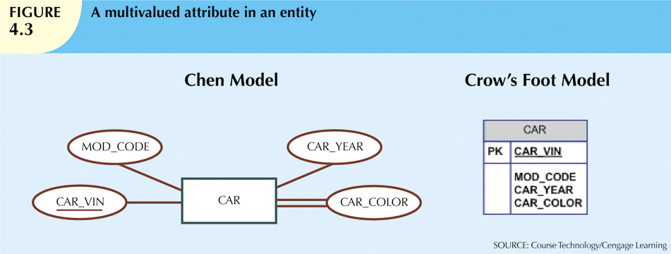
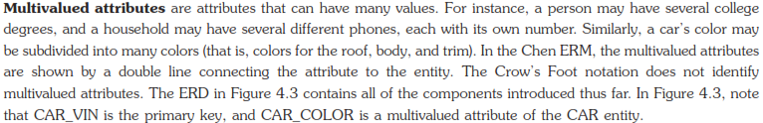
Attributes (cont’d.)

Slide 13
Attributes (cont’d.)
M:N relationships and multivalued attributes should not be implemented
Create new entity composed of original multivalued attributes’ components

Slide 14
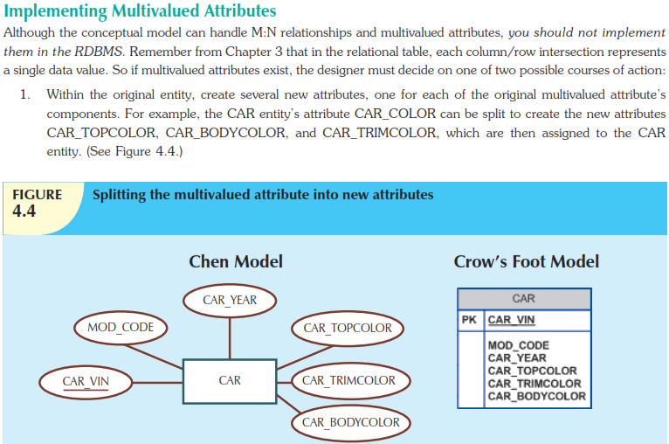

Slide 15
Attributes (cont’d.)
A derived attribute is an attribute whose value is calculated (derived) from other attributes.
The derived attribute need not be physically stored within the database; instead, it can be derived by using an algorithm.

Slide 16
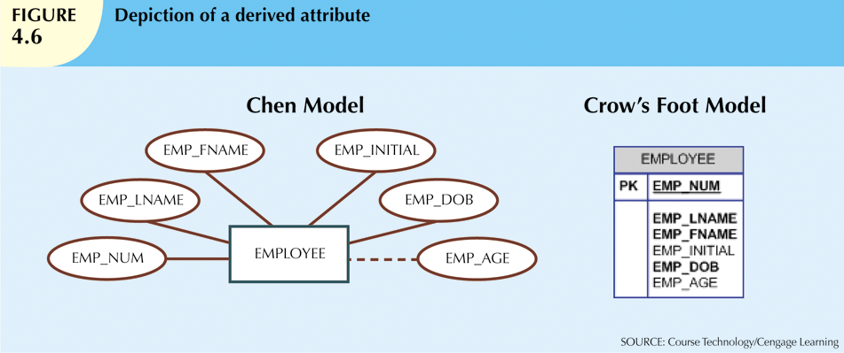
For example, an employee’s age, EMP_AGE, may be found by computing the integer value of the difference between the current date and the EMP_DOB.
If you use Microsoft Access, you would use the formula INT((DATE() – EMP_DOB)/365).

Slide 17
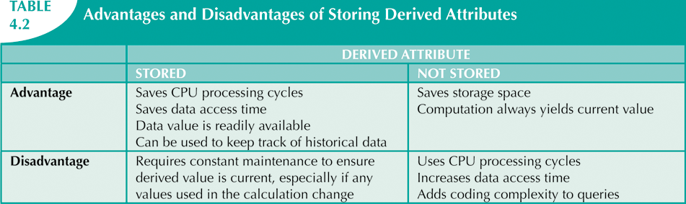

Slide 18
Connectivity and Cardinality
Connectivity
Describes the relationship classification: 1:1 or 1:M or M:N
Cardinality
Expresses minimum and maximum number of entity occurrences associated with one occurrence of related entity
Established by very concise statements known as business rules

Slide 19
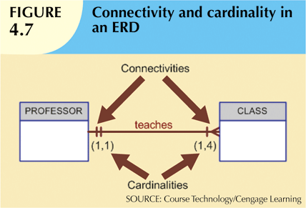
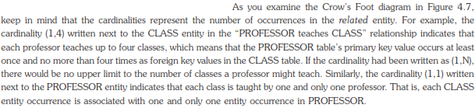

Slide 20
Existence Dependence
Existence dependence
means that an instance of one entity cannot exist without the existence of some other related entity.
Ex: Transactions are existence dependent on accounts.
Existence independence
Entity can exist apart from one or more related entities

Slide 21
Relationship Strength
Weak (non-identifying) relationships
Exists if PK of related entity does not contain PK component of parent entity
Strong (identifying) relationships
Exists when PK of related entity contains PK component of parent entity

Slide 22
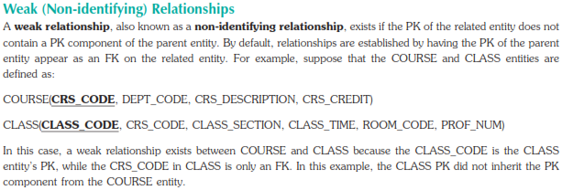

Slide 23
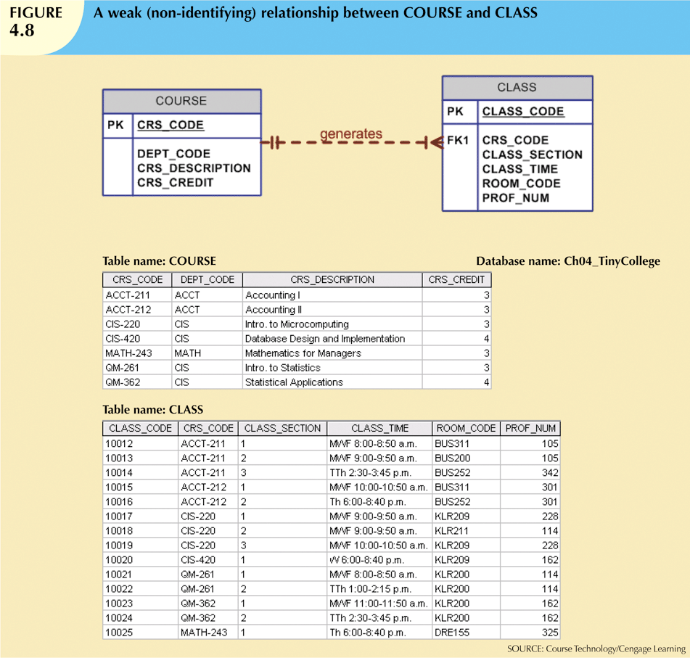

Slide 24
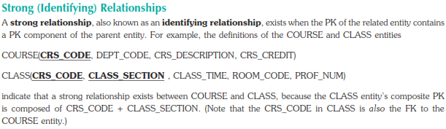

Slide 25
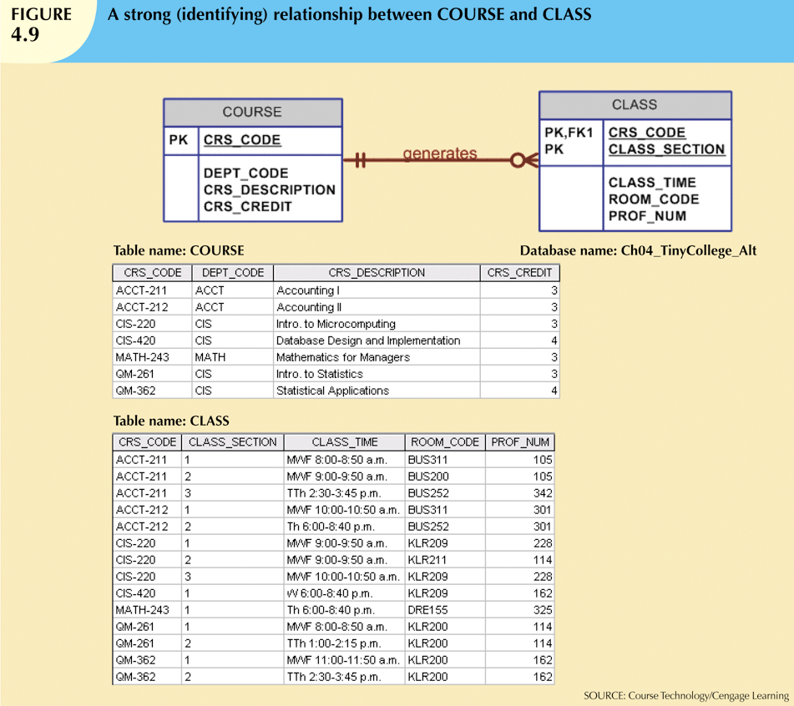

Slide 26
Weak Entities
Weak entity meets two conditions
Existence-dependent
Primary key partially or totally derived from parent entity in relationship
Database designer determines whether an entity is weak based on business rules

Slide 27
Relationship Participation
Optional participation
One entity occurrence does not require corresponding entity occurrence in particular relationship
Mandatory participation
One entity occurrence requires corresponding entity occurrence in particular relationship

Slide 28
Optional participation
For example, in the “COURSE generates CLASS” relationship, at least some courses do not generate a class.
In other words, an entity occurrence (row) in the COURSE table does not necessarily require the existence of a corresponding entity occurrence in the CLASS table.
Therefore, the CLASS entity is considered to be optional to the COURSE entity

Slide 29
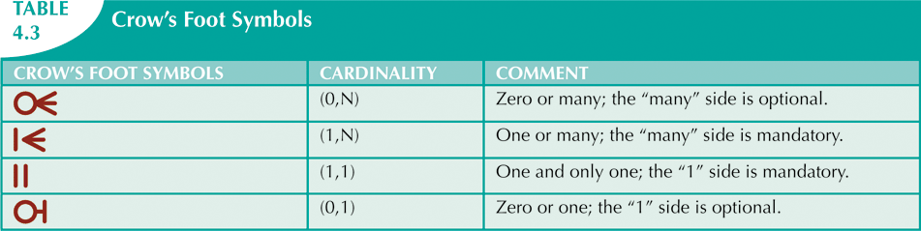

Slide 30
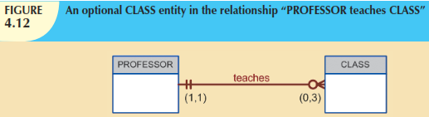
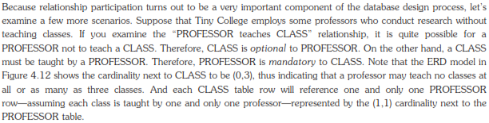
Distinction between mandatory or optional

Slide 31
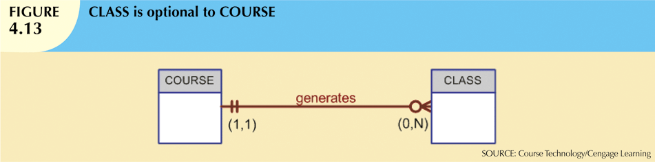

1- Class is optional
2- Class is mandatory

Slide 32
Relationship Degree
Indicates number of entities or participants associated with a relationship
Unary relationship
Association is maintained within single entity
Binary relationship
Two entities are associated
Ternary relationship
Three entities are associated

Slide 33
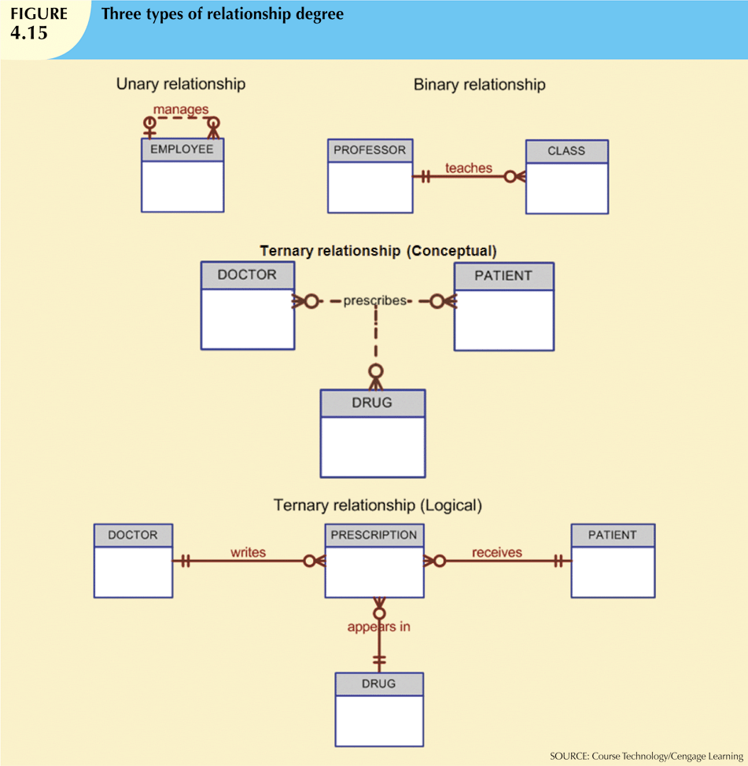

Slide 34
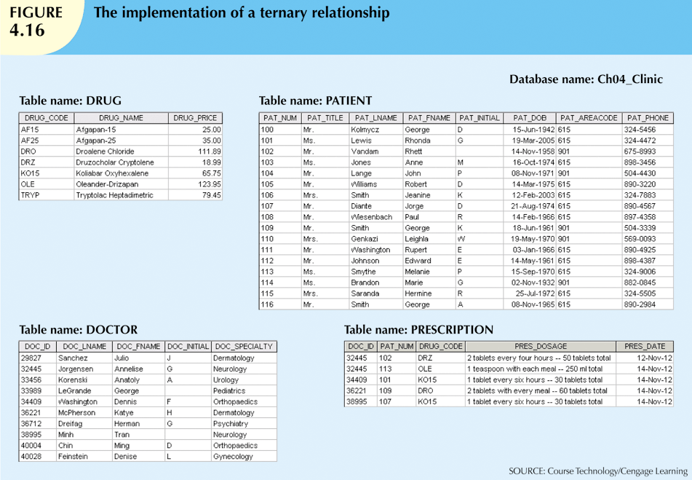

Slide 35
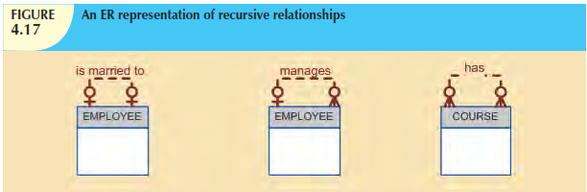
Recursive Relationships
Relationship can exist between occurrences of the same entity set
Naturally found within unary relationship

Slide 36
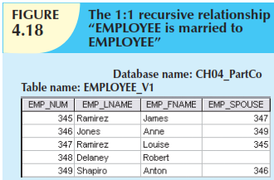
Recursive Relationships
1:1 unary relationship may be expressed by “an EMPLOYEE may be married to one and only one other EMPLOYEE.”

Slide 37
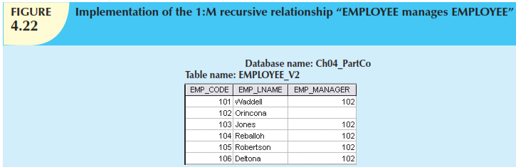
Recursive Relationships
the 1:M recursive relationship “EMPLOYEE manages EMPLOYEE,” is implemented in Figure 4.22.

Slide 38
Associative (Composite) Entities
Also known as bridge entities
Used to implement M:N relationships. You should recall from Chapter 3 that the relational model generally requires the use of 1:M relationships.
If M:N relationships are encountered, you must create a bridge between the entities that display such relationships. The associative entity is used to implement a M:N relationship between two or more entities.

Slide 39
Associative (Composite) Entities
This associative entity (also known as a composite or bridge entity) composed of the primary keys of each of the entities to be connected. An example of such a bridge is shown in Figure 4.23.
May also contain additional attributes that play no role in connective process

Slide 40
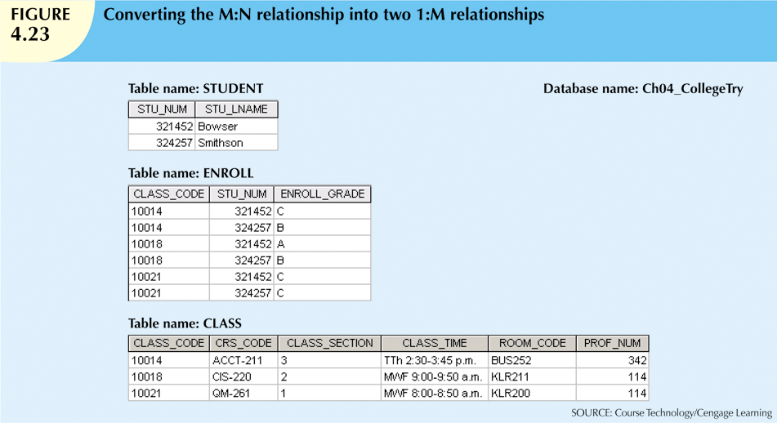

Slide 41
